Slide 1
VPF, NPS &FBP Benefits

Slide 2
Content
VOLUNTARY PROVIDENT FUND (VPF)
NATIONAL PENSION SCHEME (NPS)
FLEXIBLE BENEFIT PLAN (FBP)

Slide 3
VPF contribution
Employee can contribute 88% max if his/her PF is 12%
Tax Benefits of VPF
Account Types/Features | VPF
Tax Benefit | Up to Rs.1.5 lakh under Section 80C
Eligibility | Employees in India
Employer contribution from Basic + DA | NA
Employee contribution from Basic + DA | Up to 88% of basic and dearness allowance
Tax Returns on Maturity | Tax Free
Investment Period | Till retirement or resignation, whichever is earlier
Interest rate (subject to change) | 8.10%

Slide 4
NATIONAL PENSION SCHEME (NPS)
Benefits for existing NPS subscribers under Section 80CCD
Nature | Section | Maximum deduction | Note
Deduction for employer contribution | 80CCD(2) | 10% of Basic | Outside of 80C and 80 CCD(1B) limits
Deduction for employee’s contribution | 80CCD(1) | Max up to Rs.1,50,000 | Within Section 80C
Self-contribution to NPS | 80CCD(1B) | Rs.50,000 | In addition to 80C and 80 CCD(2)

Slide 5
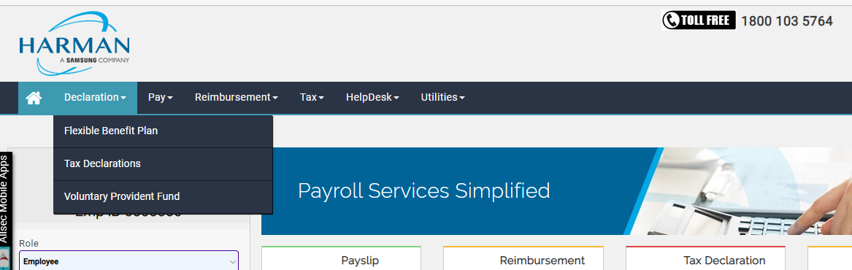
ESS Portal menu to FBP
Under Declaration employee can view, Flexible Benefit plan

Slide 6
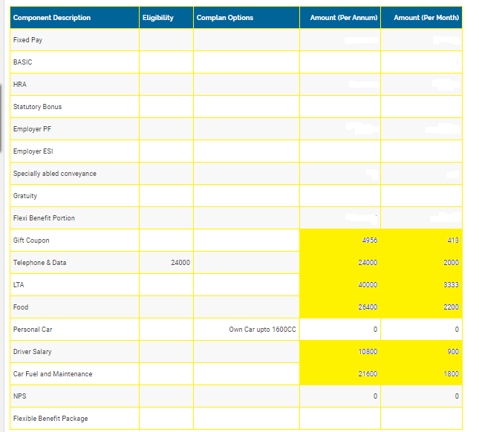
FBP Page

Slide 7
FBP Page
Employee can opt below options From FBP:
Food: 26400/13200
Telephone: Max : 24000 Max
Gift: 4956 Fixed
LTA: As much available in Special allowance
Fuel: Below 1600CC 21600 Above 1600CC then 28800
Driver: 10800
NPS: Maxi 10 percentage of Basic.
Except operator, contract and stipend all employee can opt FBP pages

Slide 8
Thank You

